Slide 1
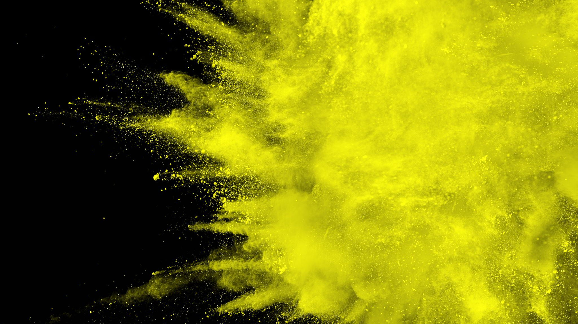
Rates of Reaction
Measuring the rate of reactions

Slide 2
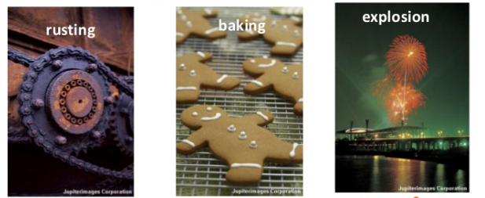
What does rate of reaction mean?
The speed of different chemical reactions varies hugely. Some reactions are very fast and other are very slow.
The speed of a reaction is called the rate of the reaction
Classify the following reactions:

Slide 3
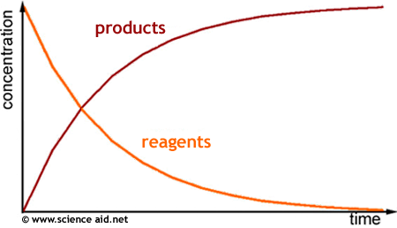
Measuring rate of reaction
Rate of reaction = amount of substance used or produced time taken
Can be measured in moles per second, grams per second, litres per second
Shows the formation of products or the consumption of reactants

Slide 4
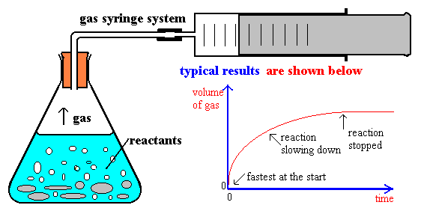
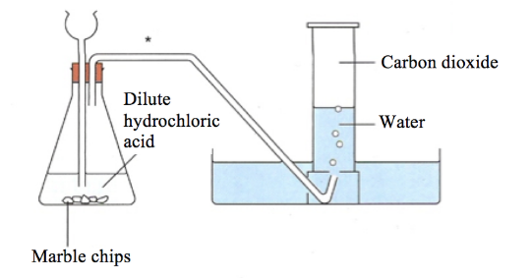
Measuring rate of reaction
Acid plus a carbonate:
CaCO3(s) + 2HCl(aq) → CaCl2(aq) + CO2(g) + H2O(l)
We can measure the rate of formation of the gas

Slide 5
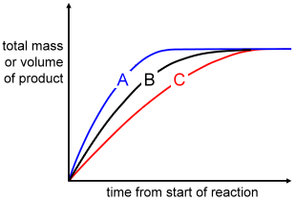

Measuring rate of reaction
A reaction rate is usually very fast at the start of a reaction as there are more reactants
As the reactants become consumed the reaction rate slows down
The steepness of the curve shows an increase in reaction rate
The levelling out shows that the reaction has gone to completion
+
→

Slide 6
Factors affecting rate
Factors that effect rate of reaction
Concentration / Pressure
Surface area
Temperature
Catalysts
Complete the BBC bitesize activity to explore the factors that affect reaction rate. Start with the revision slides (1 to 8) then do the test. Make sure you add notes to your Chemistry notebook (including any example graphs).
https://www.bbc.co.uk/bitesize/guides/zct4fcw/revision/1

Slide 7
On going work
Read Pearson 18.1 and complete the section review questions

